Slide 1
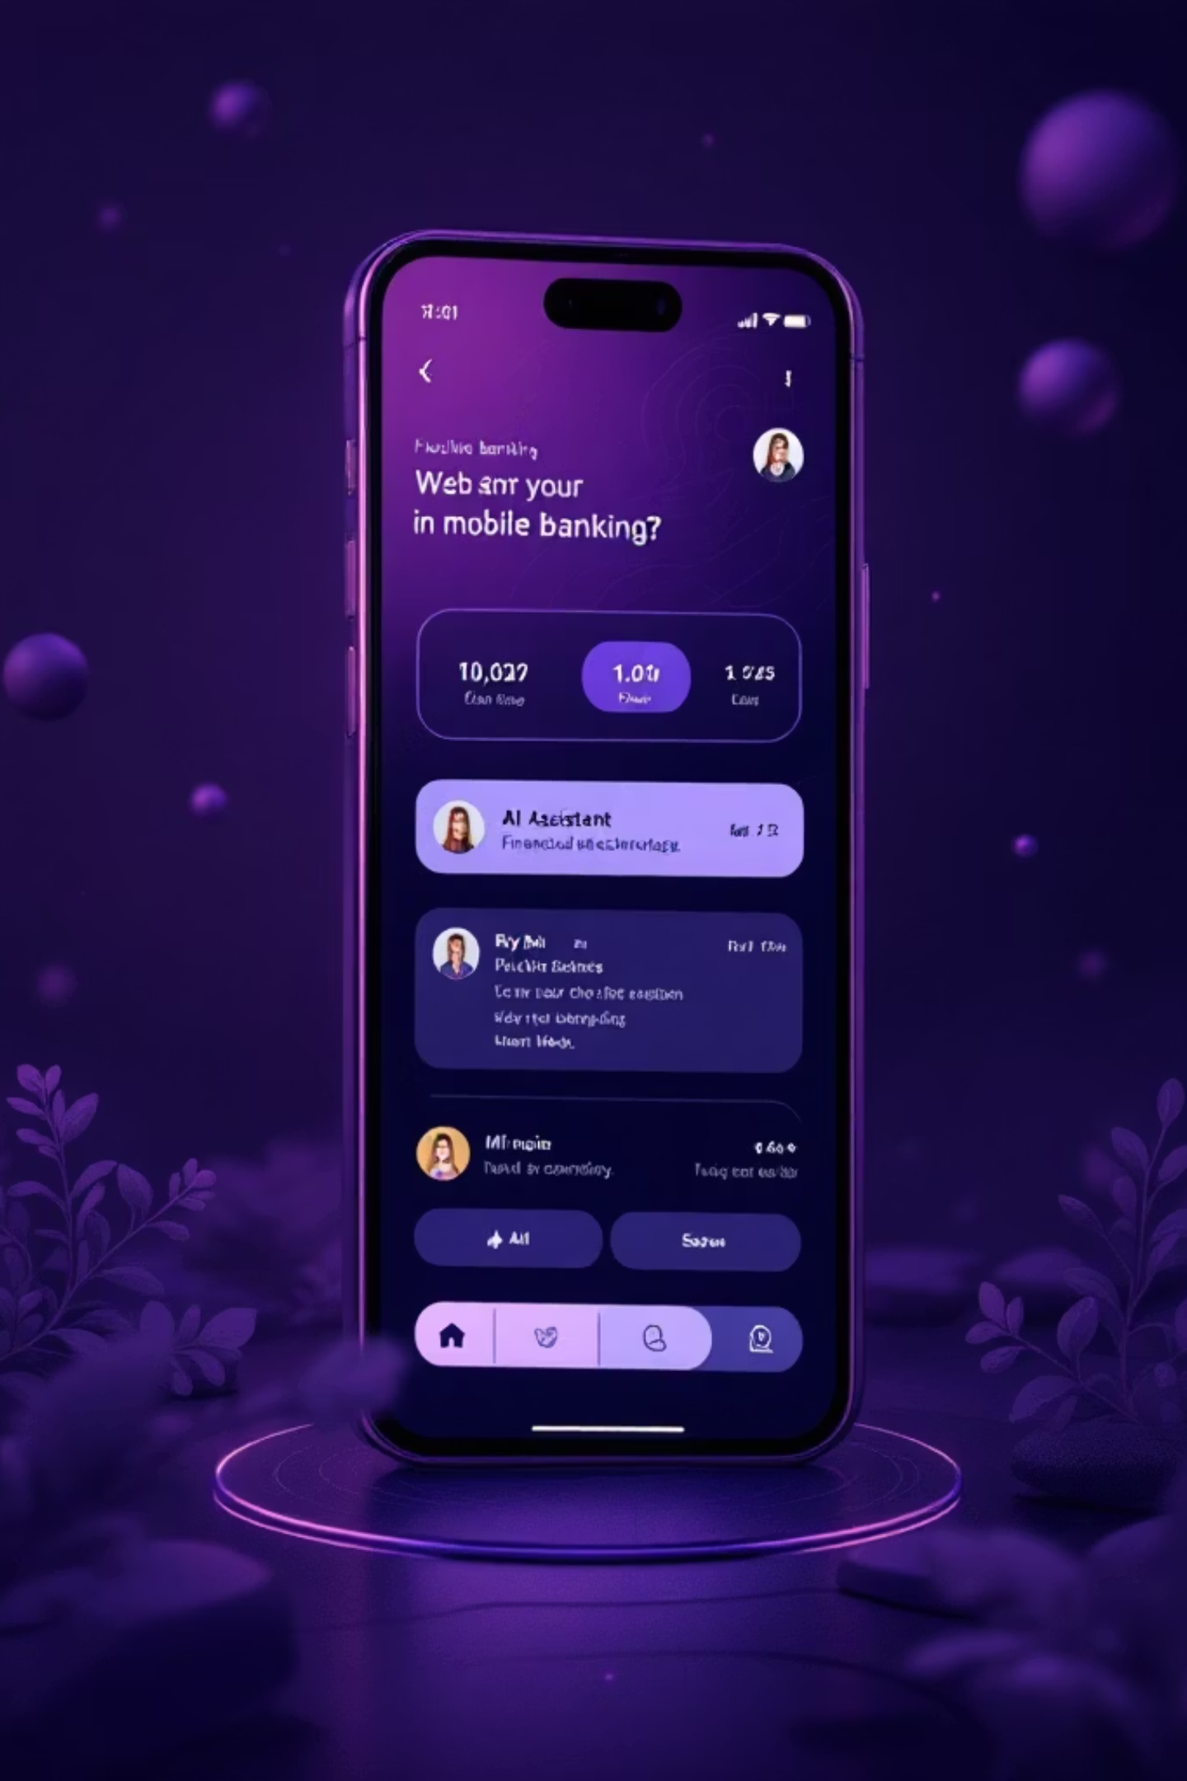
AI Personal Banking Assistant
Your Intelligent Financial Companion
Hack-O-NiT 2026 | AI UTKARSH | Narula Institute of Technology

Slide 2
India's Financial Literacy Crisis
27%
70%
₹1.5T
Financially Literate
Don't Track Expenses
Annual Loss
Only 27% of Indian adults understand basic financial concepts
Young professionals fail to monitor their daily spending patterns
Crore lost yearly due to poor financial decisions and lack of guidance
No personalized financial guidance available for millions of Indians who need it most.

Slide 3
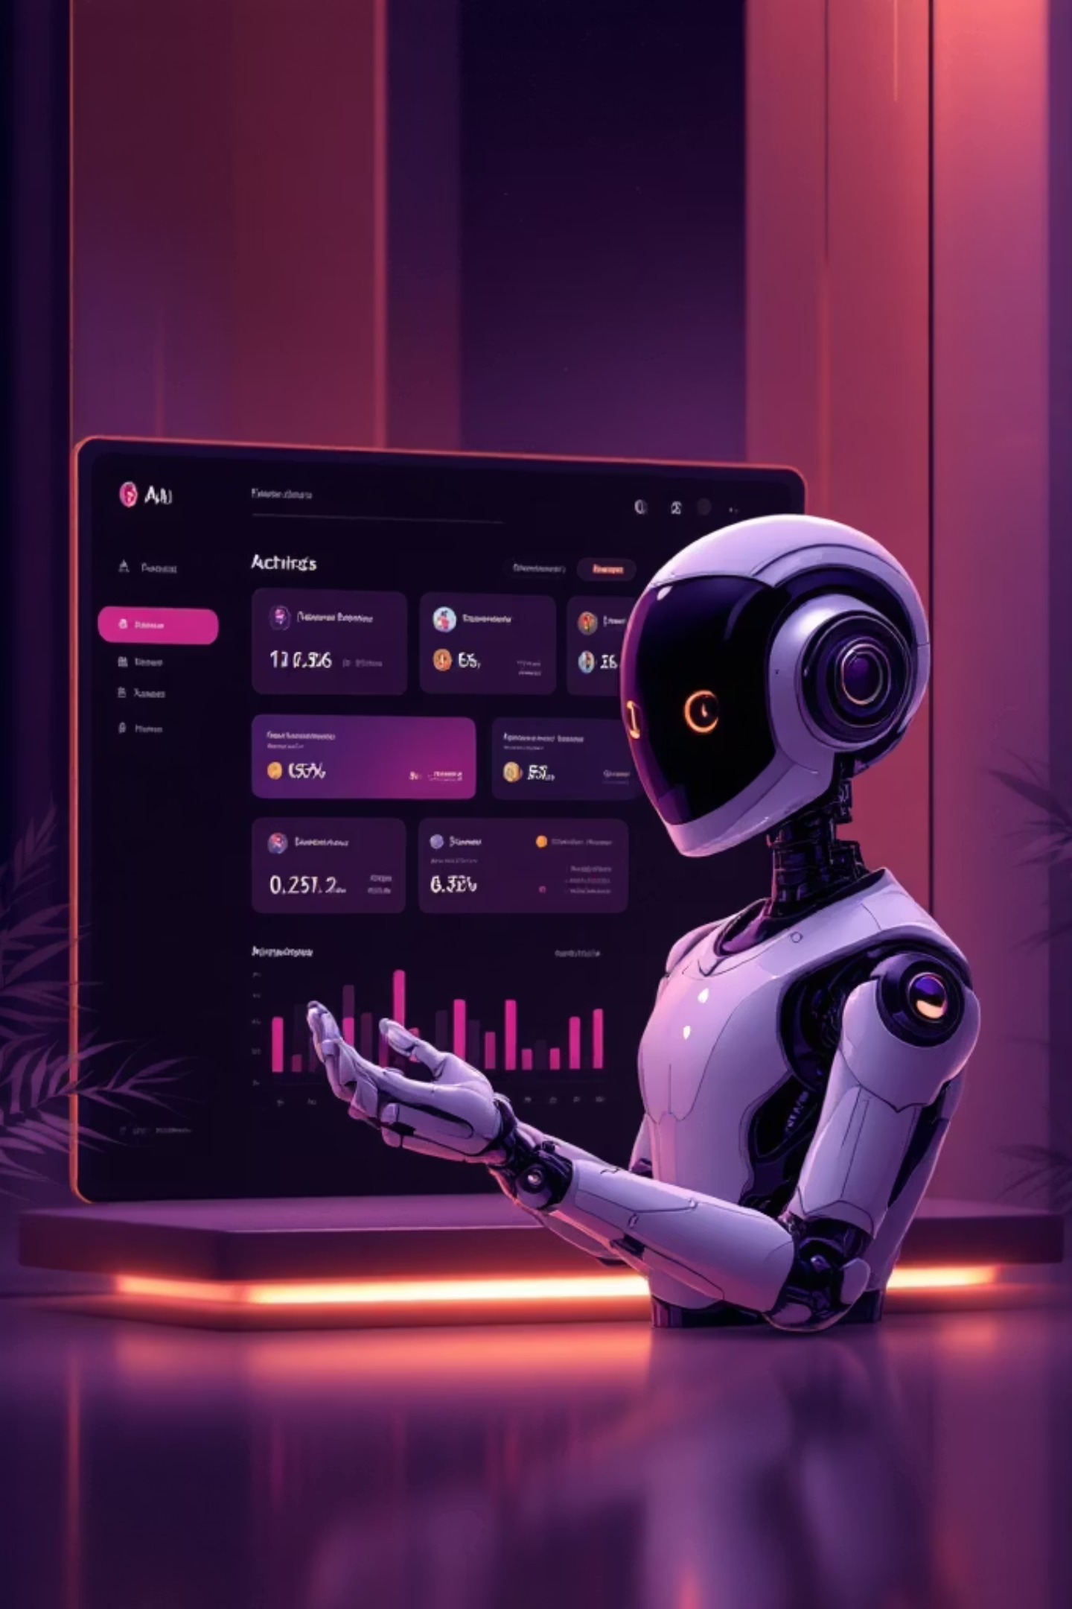
Meet Your AI-Powered Financial Companion
One intelligent assistant that analyzes, predicts, advises, and helps you grow your money. Powered by machine learning and designed for India's unique financial landscape.

Slide 4




Core Features
Expense Analysis
Behavior Detection
Automatically categorizes transactions by analyzing patterns, merchant names, and spending behavior
Identifies unnecessary spending patterns, frequent small expenses, and weekend overspending alerts
Balance Prediction
Smart Savings
AI forecasts end-of-month balance with risk alerts for low balance scenarios and emergency situations
Personalized where-to-cut suggestions with safe savings amount calculator based on your income

Slide 5
Intelligent Fixed Deposit Recommendations
Killer Feature: AI FD Advisor
Smart FD Suggestion
Emergency Check
"You can invest ₹2,000 safely in FD this month based on your cash flow analysis"
"FD not recommended due to low balance. Maintain emergency fund first"
Goal-Based FD
Idle Money Detection
"To reach ₹20,000 in 6 months, invest ₹3,200/month with 6% interest"
"₹8,000 unused for 20 days—consider FD to earn ₹80/month interest"

Slide 6
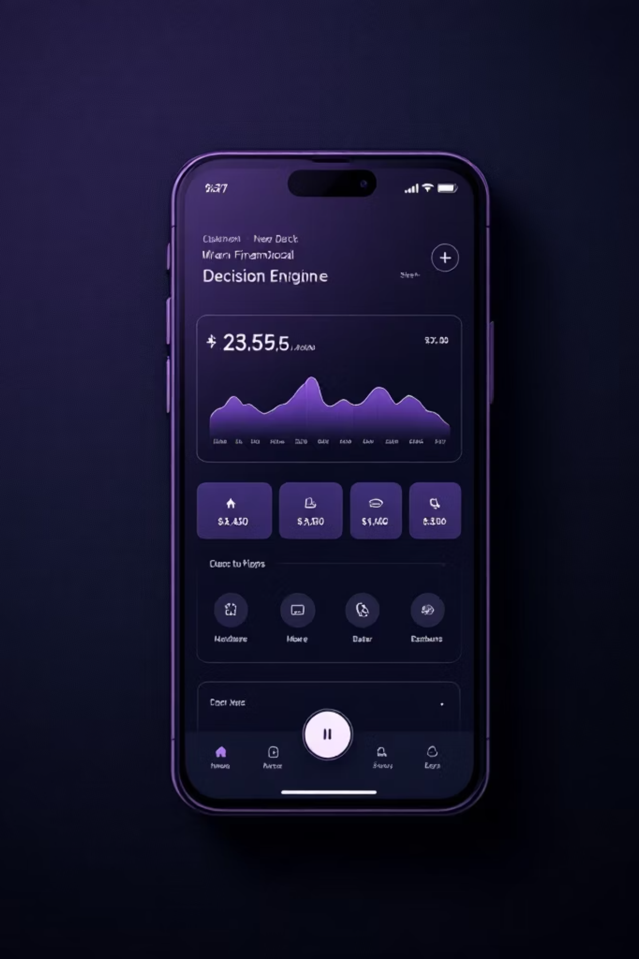




The Decision Engine You've Always Wanted
Killer Feature: "Can I Afford This?" Button
Example 1
Example 2
User: "Can I buy a phone worth ₹8,000?"
User: "Can I buy a phone worth ₹8,000?"
❌ Output: "Not recommended. This purchase may cause balance shortage after 20th."
✅ Output: "Safe to buy. You will still maintain ₹3,000 buffer."
Future Balance Check
Expense Analysis
Savings Goals Review
FD Impact Evaluation

Slide 7

How It Works - Behind the Scenes
Intelligent outputs
User CSV upload
Alerts, tips, FD advice
Initial transaction import
How It Works - Behind the Scenes
Data cleaning
Balance prediction
Forecast cash flow
Normalize and dedupe records
Pattern analysis
AI categorization
Detect spending trends
Assign merchant & category

Slide 8




AI Intelligence Stack
ML Classification
Pattern Analysis
Random Forest and SVM algorithms for accurate transaction categorization with 92% precision
Anomaly detection algorithms identify unusual spending behavior and flag potential issues
Time-Series Forecasting
Rule + AI Logic
Prophet and LSTM models predict future balances with 85% accuracy based on historical patterns
Hybrid system combines expert financial rules with machine learning for reliable FD recommendations

Slide 9





Live Demo
Dashboard View
Real-time financial overview with personalized insights
Analysis Charts
Interactive visualizations of spending patterns
Prediction Graph
Future balance forecasts with confidence intervals
FD Advisor
Smart fixed deposit recommendations in action
Decision Engine
"Can I Afford This?" feature with real examples

Slide 10
Real Impact. Real Numbers.
70%
₹6K
₹600Cr
Financial Decision Improvement
Annual Savings Potential
Scale Impact
Users make 70% more informed financial decisions after using the assistant
Average user can save ₹6,000 per year through intelligent recommendations
Annual small savings potential at scale with 1 million users
From Hackathon to Reality
Phase 1 (3 months)
Phase 3 (1 year)
Pilot with 1 bank partner
Full banking API integration + personal finance suite
1
2
3
Phase 2 (6 months)
Integration with UPI apps (PhonePe, GPay)
Why We Deserve the ₹15,000 Prize
Solves India's #1 financial literacy problem
5 AI capabilities in one seamless product
2 unique features no other team has (FD Advisor + "Can I Afford?")
Working demo with real transaction data
Direct path to commercialization with banks

Slide 11





The Minds Behind the Innovation
Rakshita
Saheli Mondal
Srishti Patel
AI/ML Engineer
Data Analyst
UI/UX Designer
Saurabh Prakash
Himanshu Singh
Full Stack Developer
Data Analyst
Let's Make India Financially Smart
#AIUtkarsh2026 #HackONiT

